Slide 1
Kimberly-Clark Automated Maintenance System Proposal
31 May 2023

Slide 2
Objective:
To develop an automated preventive maintenance system that will replace the current manual TPM planning on our machines.
Categories:
A. Corrective Maintenance – for expensive parts that needs to implement a run to failure strategy for cost saving drives (conveyor belts, motors). Approx. Less than 5%
B. Preventive Maintenance - cleaning, inspection, lubrication, adjustment or parts replacement based on historical data (time based/ usage based). Approx. around 25%
C. Predictive Maintenance – parts replacements based on trends monitoring (e.g. panel bonder module heater fluctuations)
and also based on issues recorded on our process log that’s need to be settled before it creates a bigger problem or items seen during routine inspections (e.g. gearbox oil leak) approx. around 70%

Slide 3
Production Line User Interface (Sample only)
Sec 0
Sec 1
Sec 2
Sec 3
Sec 4
Sec 5
Sec 6
Sec 7
Sec 8
Sec 9
Top Priority Items
Corrective Maintenance Recording

Slide 4
Production Line User Interface (with PM Alarms highlighted in yellow)
Sec 0
Sec 1
Sec 2
Sec 3
Sec 4
Sec 5
Sec 6
Sec 7
Sec 8
Sec 9
Top Priority Items
Corrective Maintenance Recording

Slide 5
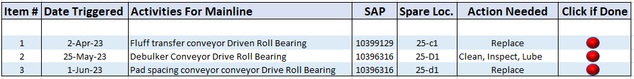
Production Line User Interface (with user interaction)
Once click a PM items window will pop out
Sec 0
Sec 1
Sec 2
Sec 3
Sec 4
Sec 5
Sec 6
Sec 7
Sec 8
Sec 9
Once click a PDM items window will pop out
Recording of unplanned activity items
After PM item is done the Technician will click done and it will automatically update the PM database and calculate the next PM Schedule for the following item
Top Priority Items
Corrective Maintenance Recording
Corrective Maintenance Recording

Slide 6
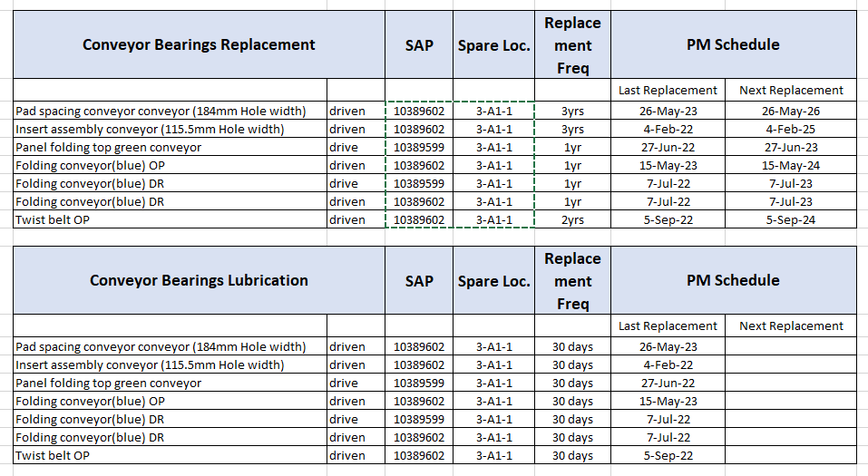
Database (Sample)
Data will be updated in this database and it will be use by the system to trigger the next PM items.

Slide 7
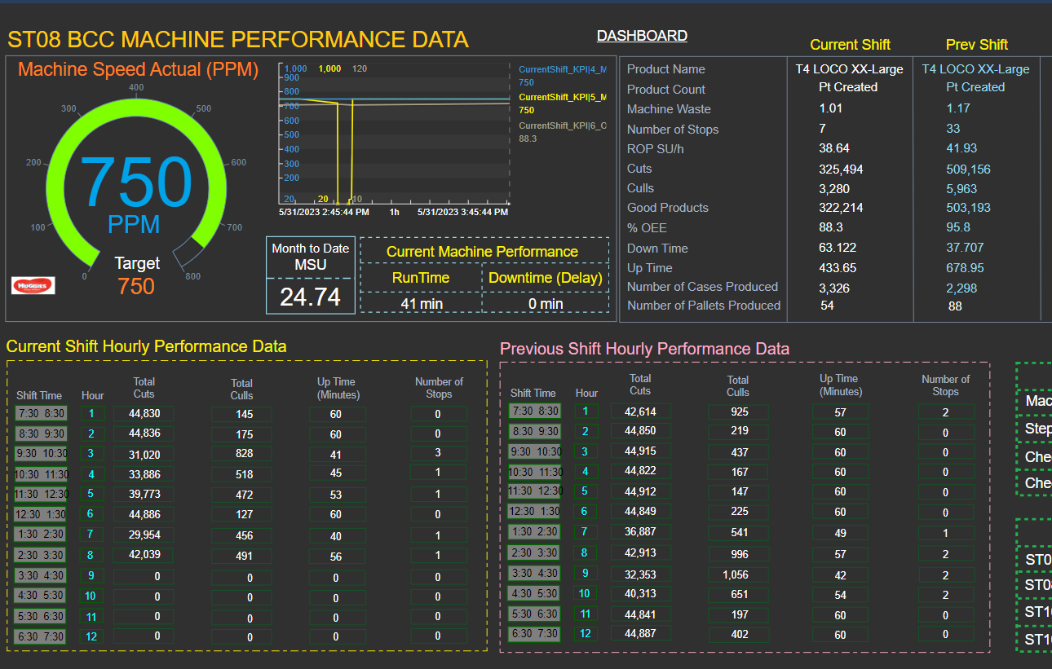
OSI Dash Board (for easy monitoring by all concerned personnels)
For Illustration Purposes only

Slide 8
System Flow Chart
Start
Unplanned Activities Done
(Replacement of parts due to failure/ failure stage)
A. Corrective Maintenace
Manual Input the unplanned items done at user interface
Database will auto update
OSI Dashboard will auto update
End

Slide 9
System Flow Chart
B. Preventive Maintenance
Done button will be click by PT @ user interface
Start
If PM due date is reached database will send alarm signal to user interface
Database will autoupdate and recalculate the next PM date
User interface will show yellow alarm on affected machine section
OSI Dashboard will auto update
PM items done?
No
Yes
End

Slide 10
System Flow Chart
C. Predictive Maintenance
Start
User Interface will display yellow alarm on priority items
Database will auto update and recalculate the next PM date
Plan activities based on issues detected thru equipment monitoring or routine inspection results
PM items done?
OSI Dashboard will auto update
No
PS will manually input the activities in the database (set as priority)
Yes
End
Database will send signal to User Interface
Done button will be click by PT @ user interface

Slide 11
Summary:
Production Line User Interface
PT will be able to check what necessary PM items needs to be done whenever there is an opportunity down.
PT will also be able to update all the items that they have done.
This user interface is also link to a database
B. Database
This is where all the PM item list are located, including historical data and calculations of when the next PM for a particular item is scheduled.
C. OSI DashBoard
Here we can display all the necessary monitoring items such as, PM items done, Pending PM items, PM Cost, PM Delays etc.
end

